Slide 1
Speed of COVID-19 Vaccine Development
By- Yashu Ranparia

Slide 2
In just under nine months, vaccines for COVID-19 were developed, tested in clinical trials, reviewed, and approved for emergency use by regulators and are now being administered to millions of people worldwide.
A number of factors made this accelerated pace possible, while maintaining the same thorough testing and rigorous safety standards as for any other medicine or vaccine.

Slide 3
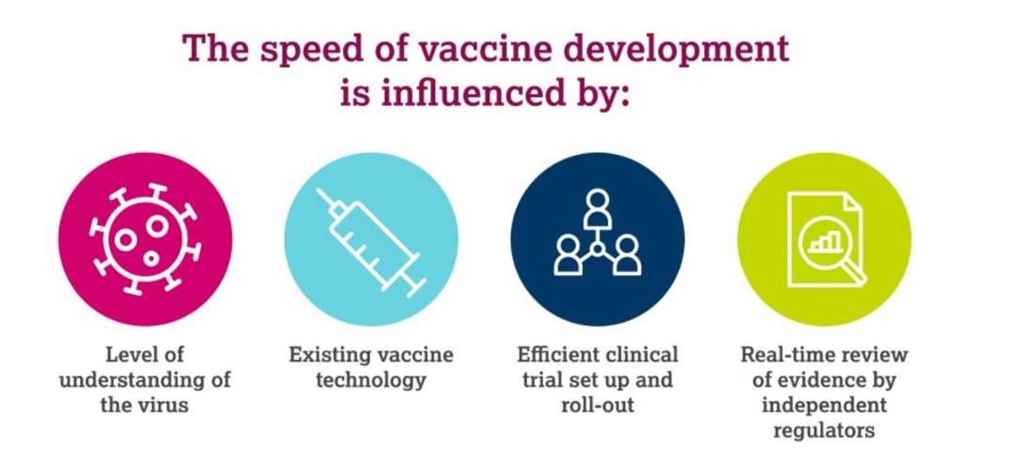

Slide 4
Pandemic planning started years ago
Experts had been preparing for a possible, viral pandemic for years. Without knowing exactly what might cause an outbreak, there was already ongoing research to advance scientific understanding and strategies in place to move quickly to develop a vaccine in the shortest possible time should a new virus of concern emerge.

Slide 5
Coronaviruses were already well understood
When the SARS-CoV-2 virus emerged, scientists already understood a lot about the ‘coronavirus family’. Coronaviruses have been around for many years and they have tried to jump from animals to humans before too, including the SARS coronavirus in 2002 and MERS coronavirus in 2012.²
This meant that scientists weren’t starting from scratch – they already knew a little about coronavirus biology, how the SARS-CoV-2 virus might spread and how to target it with a vaccine.

Slide 6
Vaccine development technology already existed
Fortunately, the technology and ‘platforms’ that allowed scientists to develop vaccines quickly already existed and were already tested in humans before the COVID-19 pandemic began.
Vaccine platforms such as ‘viral vectors’ and ‘mRNA’ had been studied for many years. Viral vector vaccines had already been tested in clinical research for Ebola⁴, prostate cancer⁵, MERS², malaria, tuberculosis, and influenza⁶ and have consistently shown to be effective with acceptable safety profiles. This research, combined with a wealth of documented experience with different vaccines in humans, meant the COVID-19 vaccines could be advanced quickly into clinical trials based on what was already known.

Slide 7
Clinical trials were conducted quickly but without shortcuts
As with all clinical development the highest standards of both safety and ethics were upheld throughout the development process, following the principles developed by world health and regulatory organizations.
Many thousands of people also helped by quickly volunteering for clinical trials. Due to public interest, these trials enrolled participants much faster than normal. The trial period was also relatively short for key data readouts which meant it didn’t take long to establish that the vaccines worked. No shortcuts were taken in terms of trial quality or safety.

Slide 8
Global collaboration at speed
The impact of global collaboration to identify and develop strategies to overcome the pandemic cannot be underestimated. Researchers, doctors, scientists, approval boards, regulatory groups, governments, manufacturers (and more) mobilized quickly with everyone working hard and fast to make vaccines available as soon as possible, while maintaining the same high standards and quality expected of any medicine.
The real-world evidence starting to emerge for these vaccines affirms that this approach has contributed to reducing the burden of illness from COVID-19 and to saving lives.

